Slide 1
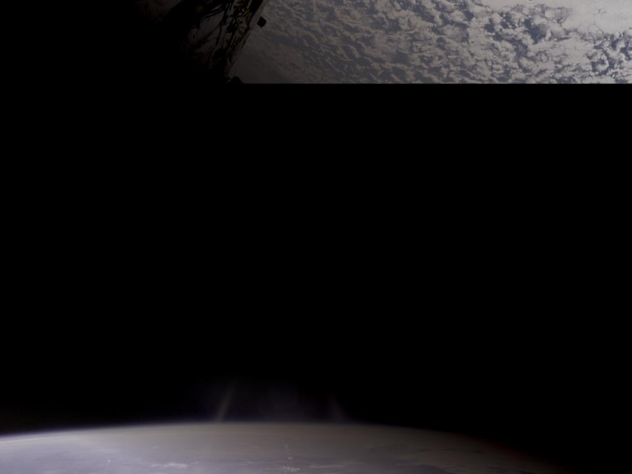
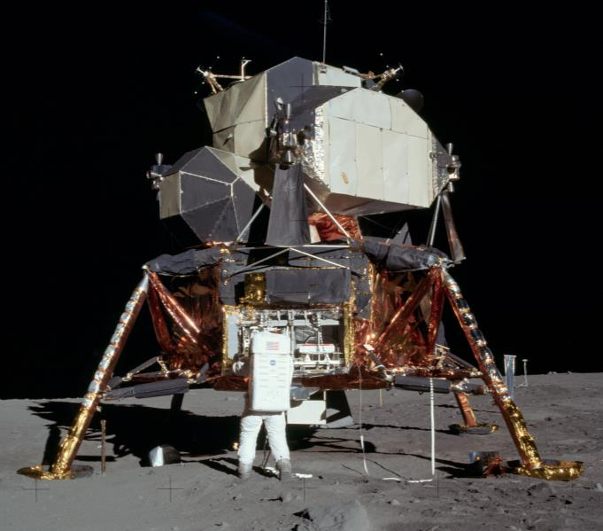
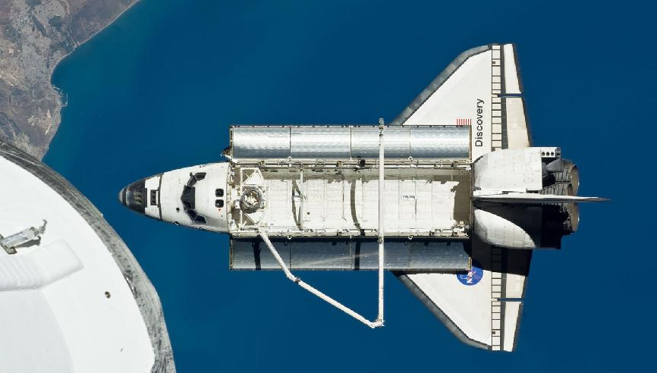
Filming in Space
From
Apollo
to
The Space Shuttle Discovery
5

Slide 2
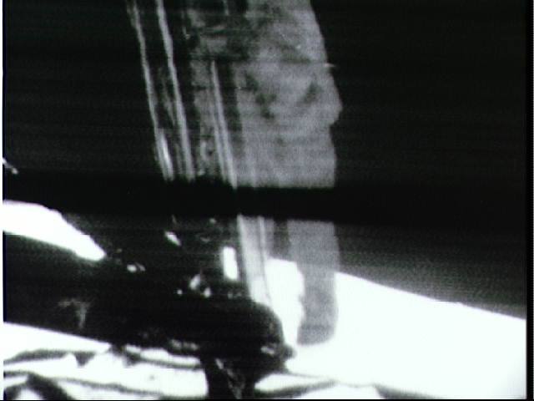
Why film in space?
Notes:
This low resolution image is a still from the television coverage of Neil Armstrong preparing to take the first human step on the Moon on July 21, 1969.
Filming has been a part of the space program since the very beginning with cameras inside Mercury spacecraft to record the astronaut’s activities. NASA studies these films to ensure that objectives of that specific mission have been met. They also use this information as they plan future missions. In the case of Apollo 11, a camera in the window of the lunar module captured this historical moment and the entire three hours of the first spacewalk on film. This film was then analyzed to prepare for future spacewalks.
If you are interested in the footage of the moon landing, you can view this:
https://www.youtube.com/watch?v=S9HdPi9Ikhk
Note, it is over three hours long. The first step takes place at about three minutes.

Slide 3
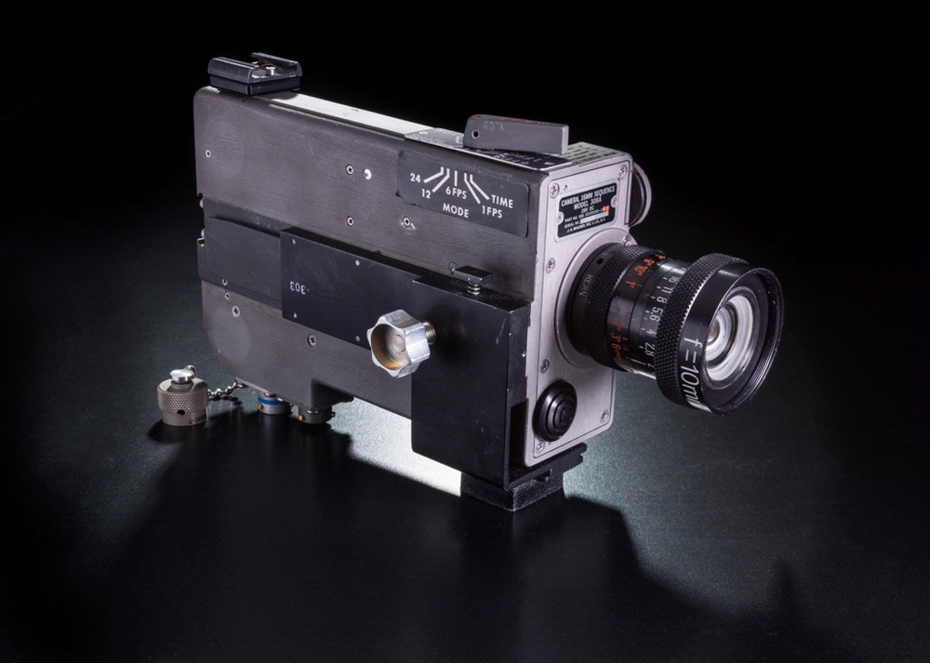
Filming on the Moon
1969
Apollo Lunar Module (LM)
Apollo 11 Data Acquisition Camera
Notes:
Mounted in the right-hand window of the lunar module Eagle, this camera filmed the first landing on the Moon. Astronauts Neil Armstrong and Buzz Aldrin later repositioned it to film their work on the lunar surface.
“Throughout the EVA, TV was useful in providing continuous observation for time correlation of crew activity with telemetered data and voice comments and in providing live documentation of this historically significant achievement. Lunar surface photography consisted of both still and sequence coverage using the Hasselblad camera, the Maurer data acquisition camera and the Apollo Lunar Surface Close-Up Camera.”
Transcribed from Apollo 11 Mission (AS-506) Post Launch Mission Operation Report No. 1
http://history.nasa.gov/ap11fj/pdf/a11-postlaunch-rep.pdf

Slide 4
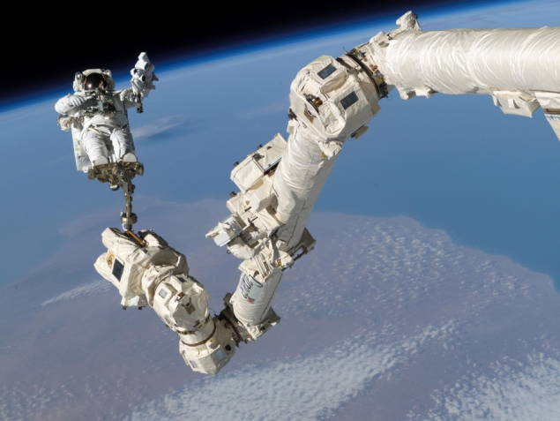
Why film on the Space Shuttle?
Astronaut Steve Robinson photographing the exterior
of the Space Shuttle Discovery to check for damage.
Notes:
Filming done on the Space Shuttle had more uses than the film shot during the early days of space exploration. While the Apollo films were studied after the fact, filming on the Space Shuttle could be viewed in real time by the crew in the cabin and the ground crew.
The closed-circuit television system is used primarily to support on-orbit activities that require visual feedback to the crew. The CCTV system also provides the capability to document on-orbit activities and vehicle configurations for permanent record or for real-time transmission to the ground. The CCTV system can be controlled by both onboard and remote uplink commands.
In addition to filming onboard activities, cameras played a major role in ensuring the safety of the space shuttles by aiding in in-flight inspection and identifying potentially dangerous damage to the Shuttle.
For more information about cameras and safety seeThe Space Shuttle’s Return to Flight Mission STS-114 Press Kit (pages 35-50)
http://www.nasa.gov/pdf/112301main_114_pk_july05.pdf
Here is a news release from STS-114:
Wednesday, July 27, 2005 – 4 p.m. CDT
Mission Control Center, Houston, Texas
07.27.05STATUS REPORT: STS-114-03
STS-114 MCC Status Report #03
Discovery crewmembers completed a camera survey of the heat shields of the leading edges of the orbiter's wings and its nose cone Wednesday. They also began preparations for Thursday's docking with the International Space Station and the mission’s spacewalks.
Commander Eileen Collins, Pilot Jim Kelly and Mission Specialists Soichi Noguchi, Steve Robinson, Andy Thomas, Wendy Lawrence and Charlie Camarda downlinked imagery taken of the External Tank after launch. The crew also photographed the Orbital Maneuvering System pod tile areas and sent down those files. Most of the heat shield survey, taking a close look at the reinforced carbon-carbon of Discovery's wings and nose was sent down live. The rest was sent down before the crew went to bed about 2:40 p.m. CDT.
The data was gathered by the new Orbiter Boom Sensor System (OBSS) laser-scanner. Kelly, Thomas and Camarda, with some help from other crewmembers, operated the Discovery's Canadarm and the 50-foot boom extension at its end for the survey. The OBSS was reberthed and Canadarm and its cameras were used to survey the tile area around the crew cabin.
Preparations for docking included a checkout of rendezvous tools, and the extension of the Orbiter Docking System ring that will make first contact with the Station. The approach will include the first Rendezvous Pitch Maneuver, a slow back flip by Discovery about 600 feet below the Station immediately before the 6:18 a.m. CDT docking.
The maneuver will allow Station Commander Sergei Krikalev and NASA Science Officer John Phillips to photograph Discovery's thermal protection system with 400mm and 800mm lenses. The images, taken through windows in the Station's Zvezda Service Module, are expected to be downlinked before hatches between Discovery and the Station are opened.
Today’s imagery and laser scans will be compiled with other imagery taken during launch, and with data collected by wireless impact sensors in each panel of the wings’ leading edges. Downlink of both preliminary and raw data from the sensors also was completed today. A team of about 200 people across the country are working to analyze imagery from the early part of Discovery's mission, the most photographed Shuttle flight in history.
The crew also completed the checkout of tools and two spacesuits to be used during the mission’s three spacewalks. Two suits were also prepared for delivery to the Station for future Quest airlock spacewalks.
The next STS-114 mission status report will be issued after crew wakeup, or earlier if events warrant.

Slide 5
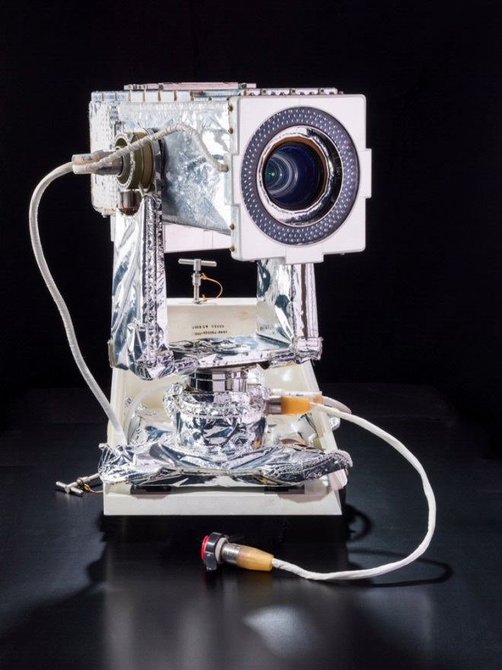
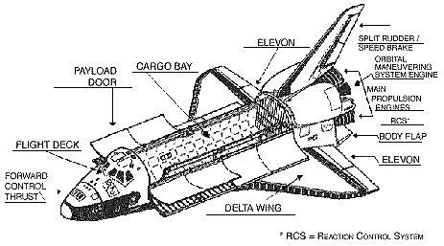
Filming on the Space Shuttle Discovery
1984-2012
Payload Bay Camera
Space Shuttle Discovery
Notes:
Positioned in each corner of the bus-sized cargo area, these cameras could be remotely pointed to wherever astronauts were working. This camera came to the Museum with Discovery in 2012 but was not reinstalled on the shuttle.
“Closed-Circuit Television System
The closed-circuit television system is used primarily to support on-orbit activities that require visual feedback to the crew. The CCTV system also provides the capability to document on-orbit activities and vehicle configurations for permanent record or for real-time transmission to the ground. The CCTV system can be controlled by both onboard and remote uplink commands. The CCTV system is a standard monochrome (black and white) system with an optional color capability by means of interchangeable camera lenses. Color scenes are not available on the onboard monitors because of hardware restrictions; however, color scenes are available on recorded and downlinked video.
Video inputs to the CCTV system are available from cameras mounted at several locations in the payload bay and on the remote manipulator system arm, which is mission dependent.
Cameras are also used in the middeck and the flight deck of the crew compartment. The video signals from these cameras can be viewed by the crew on one of two monitors in the flight deck, then sent to a video tape recorder for later viewing or to the ground on the S-band FM or Ku-band systems.
The video control unit controls power and input/output configuration, including camera control of pan, tilt, zoom, focus, iris operations and synchronization for the CCTV system. It processes video and data inputs from cameras and video tape recorder channels and routes them to monitors, the VTR or the ground by downlink.
Typical uses of the CCTV system for monitoring and recording mission activities include payload bay door operations, remote manipulator system operations, experiment operations, rendezvous and stationkeeping operations, and onboard crew activities.”

