Slide 1
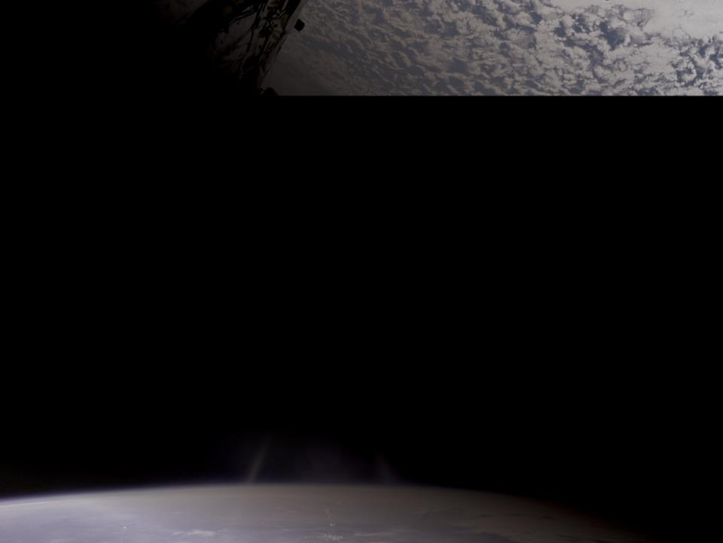
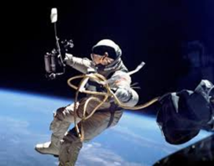
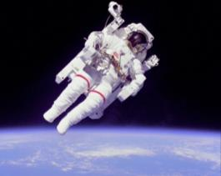
Moving Around in Space
From
The first US Spacewalk
June 3, 1965
to
The First Untethered Spacewalk
February 7, 1984
5

Slide 2
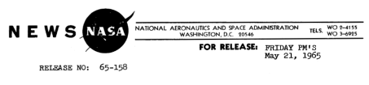
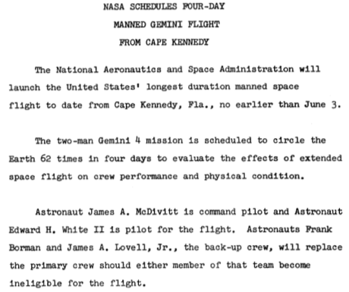
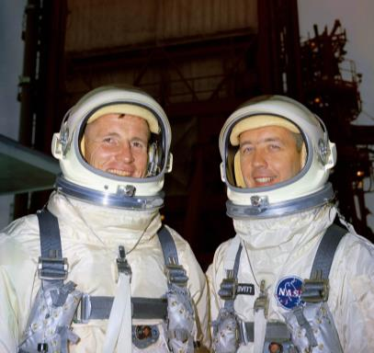
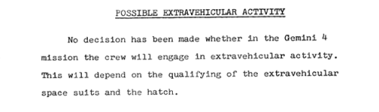
First US Spacewalk
June 3, 1965
Ed White and Jim McDivitt
Notes:
Gemini 4 was the second crewed mission of the Gemini series and carried James McDivitt and Edward White on a four-day, 62-orbit, 98-hourr flight from June 3 to June 7, 1965. The mission included the first American spacewalk. The objective of the mission was to test the performance of the astronauts and capsule and to evaluate work procedures, schedules, and flight planning for an extended length of time in space. Secondary objectives included demonstration of extravehicular activity in space, conduct stationkeeping and rendezvous maneuvers, evaluate spacecraft systems, demonstrate the capability to make significant in-plane and out-of-plane maneuvers and use of the maneuvering system as a backup reentry system, and conduct 11 experiments.
http://nssdc.gsfc.nasa.gov/nmc/spacecraftDisplay.do?id=1965-043A
Accessed 12/19/14

Slide 3

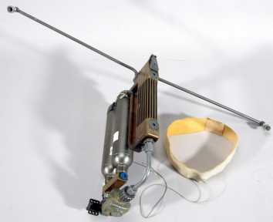
Moving Around in Space 1965
Hand-Held
Maneuvering Unit
Ed White using a Hand-Held Maneuvering Unit
Notes:
“Gemini 4's original flight plan was a fairly conservative one. […] However, early in March 1965, NASA revised the flight plan and added two extra components. […] Ed White was slated to perform a dramatic extra vehicular activity (EVA). […] White was scheduled to use a newly developed suit and a special hand held unit which would allow the astronaut to propel himself while performing maneuvers outside the spacecraft. When the original flight plan was introduced, White's suit and self-propulsion unit were still on the drawing board. In fact, the gear was not certified for use in space until ten days before the Gemini 4 launch and the EVA itself was not officially confirmed until one week before the scheduled launch. […]”
[…]
At 2:45 pm, as Gemini 4 passed beyond Hawaii, Ed White emerged through the hatch. "When I departed the spacecraft, there was no pushoff whatsoever from the spacecraft... The gun actually provided the impulse for me to leave the spacecraft." […] He reported that "the maneuvering unit is good. The only problem I have is that I haven't got enough fuel". (34) With the fuel exhausted in the hand unit, White had to rely on the twenty five foot tether to maneuver himself. He soon discovered that the gun provided much better control than the tether and that moving was much more difficult and awkward without it.”
From Detailed Biographies of Apollo 1 Crew-Ed White. For the full text, see Technical Readings.

Slide 4
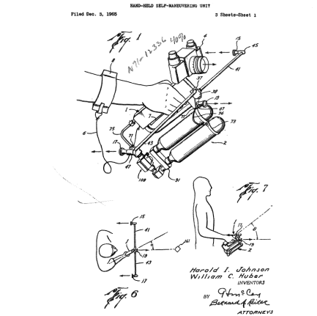
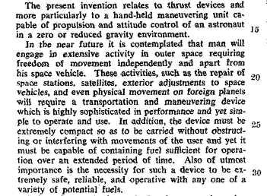
Notes:
These diagrams and text are from the US Patent for the Hand-Held Maneuvering Unit. The full text is in Technical Readings.

Slide 5
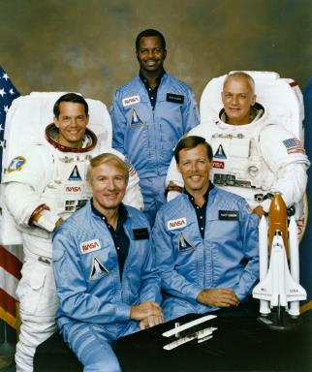
Crew of STS-41B
Launched February 3, 1984
On this mission, the first untethered spacewalks were carried out by McCandless and Stewart, using the manned maneuvering unit.
McCandless made the first, untethered, free flight on each of the two MMUs carried on board and alternated with Stewart in the activities constituting two spectacular extravehicular activities (EVAs).
Crew photo with Commander Vance Brand, Pilot Robert Gibson, Mission Specialists, Robert Stewart, Robert McNair, and Bruce McCandless
Image Credit NASA.
Notes:
NASA photograph MSFC-75-SA-4105-2C
“On this mission the first untethered space walks were carried out by McCandless and Stewart, using the manned maneuvering unit. The WESTAR-VI and PALAPA-B2 satellites were deployed, but failure of the Payload Assist Module-D (PAM-D) rocket motors left them in radical low-Earth orbits. The German-built Shuttle Pallet Satellite (SPAS), originally flown on STS-7, became the first satellite refurbished and carried back into space. SPAS remained in the payload bay due to an electrical problem with Remote Manipulator System (RMS). The RMS manipulator foot restraints were first used to practice procedures performed for Solar Maximum satellite retrieval and repair planned for next mission. Integrated Rendezvous Target (IRT) failed due to an internal issue. Five Get Away Special canisters flown in the cargo bay and Cinema-360 camera were used by crew. Other payloads included: Acoustic Containerless Experiment System (ACES); Monodisperse Latex Reactor (MLR); Radiation Monitoring Equipment (RME), and Isoelectric Focusing (IEF) payload.”
http://www.nasa.gov/mission_pages/shuttle/shuttlemissions/archives/sts-41B.html
accessed 12/22/14

Slide 6
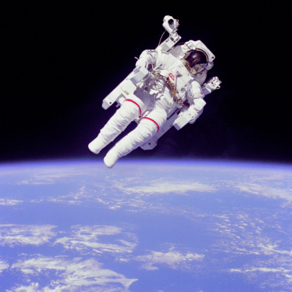
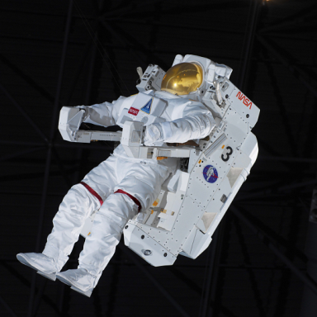
Moving through Space 1984
Manned Maneuvering Unit
on display at the
National Air and Space Museum
McCandless on an untethered spacewalk
Notes:
The Manned Maneuvering Unit (MMU) is a backpack propulsion device that gave astronauts mobility for extravehicular activities outside the Space Shuttle. It enabled them to maneuver within the payload bay or fly some distance away without needing safety tethers anchored to the vehicle. The MMU had 24 small gaseous nitrogen thrusters and was operated with hand controllers on the arms of the unit.
On February 7, 1984, on Space Shuttle mission STS 41-B, astronaut Bruce McCandless tested this MMU, serial number 3. He made the first untethered spacewalk as he flew some 300 feet from the Shuttle. This MMU also flew on missions STS 41-C as the backup unit for the Solar Max satellite retrieval and STS 51-A as the prime unit for retrieving the Palapa communications satellite. Astronauts Bruce McCandless, Robert Stewart, James van Hoften, and Joseph Allen flew MMU #3 a total of 6 hours 29 minutes during these three 1984 missions. The MMUs were not used again. NASA transferred this one to the Museum in 2001.

Slide 7
The backpack, called the manned maneuvering unit (MMU), will allow the crew to operate beyond the confines of the Shuttle cargo bay and fly to any part of their own spacecraft or to the nearby free-flying payloads or structure. This independent mobility will be used to support a wide variety of activities including free-space transfer of cargo and personnel, inspection and monitoring of orbital operations, and construction and assembly of large structures in orbit.
Transcribed from (NASA-CR-151864) Manned Maneuvering Unit: User’s Guide (Martin Marietta Corp)
Notes:
For a PDF of the Manned Maneuvering Unit: User’s Guide, check the Technical Reading section

