Slide 1
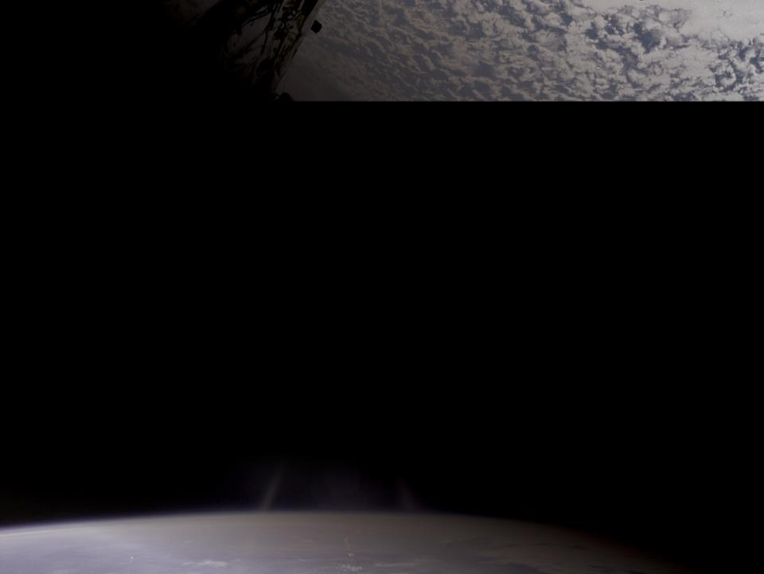
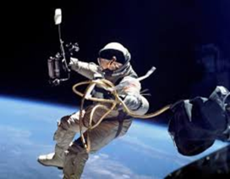
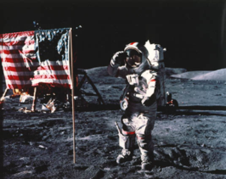
Staying Alive in Space
From
The First US Spacewalk
June 3, 1965
to
The Last Walks on the Moon
December 14, 1972
5

Slide 2
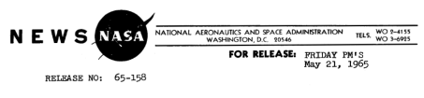
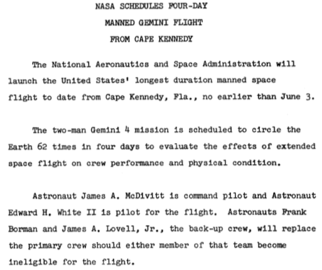
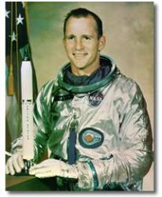
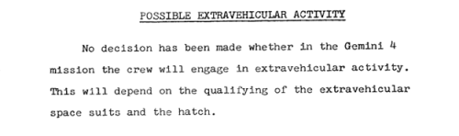
First US Spacewalk
June 3, 1965
Ed White was the first American to do a spacewalk.
He spent 23 minutes floating in space.
Notes:
The first person to do a spacewalk was Soviet/Russian Cosmonaut Aleksei Leonov. On March 18, 1965, he spent 12 minutes floating in space.
The quotes shown are excerpts from NASA’s press kit for the launch of Gemini IV. This press kit is 91 pages long—it contains a wealth of information and diagrams. The table of contents makes it easy to find information. The highlighted section on the possible EVA is from page 5, and is part of a longer section about a possible spacewalk. The PDF of this press kit is available in Technical Readings.

Slide 3

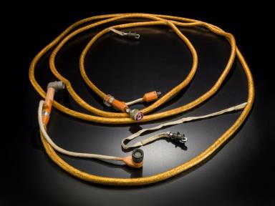
First US Spacewalk—Gemini IV
Umbilical
Ed White using the umbilical
Notes:
This umbilical is the actual 25-foot lifeline that connected Ed White to Gemini IV during his EVA so he would not float off into space. It contains a rubber oxygen hose, four electrical connectors, and a communications line. This delivered his life support. It also kept him from floating away from the spacecraft. When his hand-held maneuvering unit (shown here in White’s right hand) ran out of fuel—White used the tether to maneuver himself around the aircraft.
“Ed White was slated to perform a dramatic extra vehicular activity (EVA). On March 18, 1965, Russian cosmonaut Alesksei Leonov had become the first man to venture outside the relative safety of his spacecraft to float in space for ten minutes while attached to the Voskhod II by means of a ten foot tether. White was scheduled to use a newly developed suit and a special hand held unit which would allow the astronaut to propel himself while performing maneuvers outside the spacecraft. When the original flight plan was introduced, White's suit and self-propulsion unit were still on the drawing board. In fact, the gear was not certified for use in space until ten days before the Gemini 4 launch and the EVA itself was not officially confirmed until one week before the scheduled launch. Nonetheless, White spent countless hours practicing in the McDonnell pressure chamber to prepare himself to perform his space walk. Although a Russian had been the first to float in space, Ed White was determined to be the first to use jet propulsion to actually maneuver himself in space.”
From Detailed Biographies of Apollo I Crew-Ed White http://history.nasa.gov/Apollo204/zorn/white.htm
accessed 12/17/14
A copy of the full text is available in Technical Readings.

Slide 4
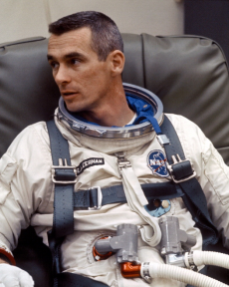
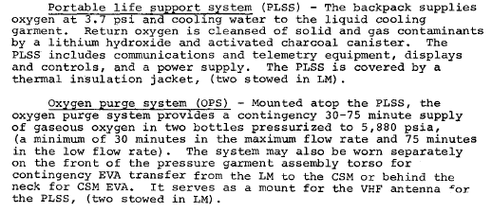
Last Man on the Moon
December 14, 1972
Eugene Cernan was the last person to walk on the Moon. Before he left, he spent a total of 74 hours, 59 minutes, and 40 seconds there from December 11 to December 14, 1972.
Notes:
The quotes are excerpts from the Apollo 17 Press Kit. It is 121 pages long. The PDF of this press kit is available inTechnical Readings.

Slide 5
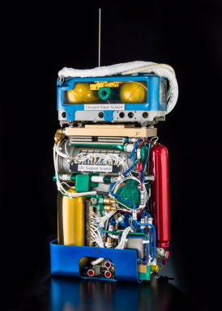
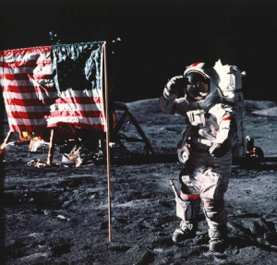
Last Walk on the Moon—Apollo 17
Cutaway model of the
Portable Life Support System
and Oxygen Purge System
Gene Cernan on the Moon
Notes:
Apollo 17 was the last mission to the Moon. Gene Cernan and Harrison Schmitt were the two astronauts selected to land on the Moon for this mission. The last to leave was Eugene “Gene” Cernan.
Technologies for life support changed after 1965. Astronauts no longer had to be attached to the spacecraft, but instead carried their life support on their backs. This enabled them to be outside for longer periods of time and to walk on the Moon.
This system is called the Personal Life Support System (PLSS) and the Oxygen Purge System (OPS). The PLSS is a backpack attached to the spacesuit by short umbilicals and provided everything the astronaut required including pressure and oxygen. The OPS was affixed to the top of the PLSS and provided backup services in case of a PLSS failure. It could provide breathable air, water for cooling the garment, pressure, and the removal of heat and vapor.
For Technical Reading about the PLSS and OPS see the PDF Apollo Lunar Surface Journal PLSS Technical Information.

