Slide 1
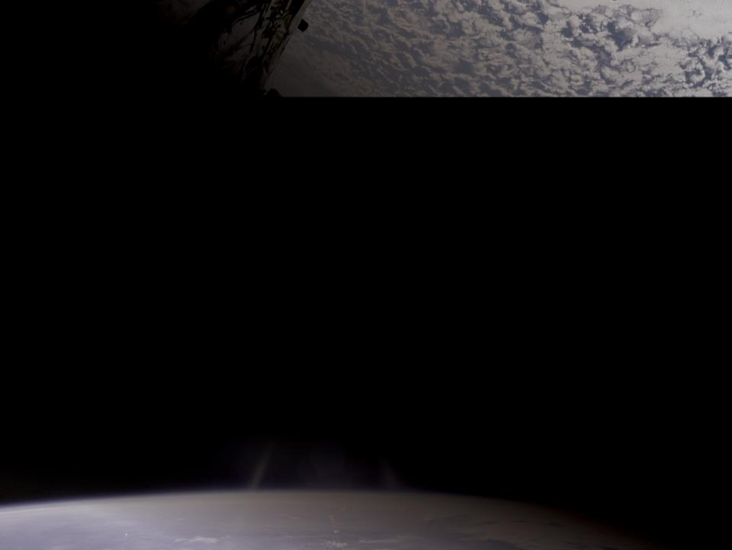
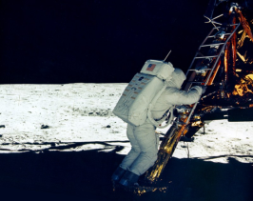
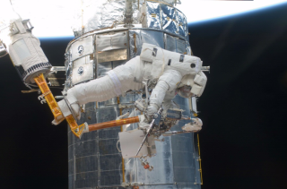
Staying Grounded in Space
From
Apollo 11
to
The Space Shuttle
5

Slide 2
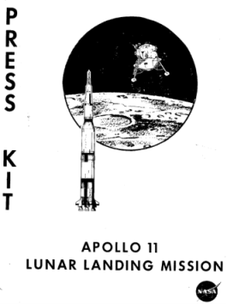
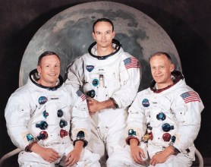
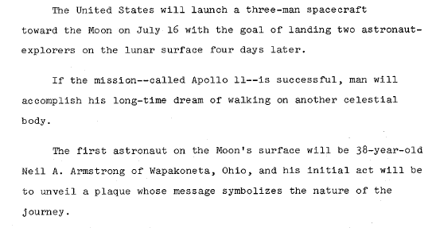
First person on the Moon
July 20, 1969
Neil Armstrong was the first person to walk on the Moon.
On his moonwalk he spent 2 hours and 35 minutes on the Moon.
Notes:
The astronauts of Apollo 11 were Neil Armstrong, Commander (left), Michael Collins, Command Module Pilot (center), and Buzz Aldrin, Lunar Module Pilot (right).
The quotes are excerpts from NASA’s press kit for Apollo 11 Mission. This press kit is 250 pages long—it contains a wealth of information and diagrams. The table of contents makes it easy to find information. The PDF of this press kit is available in Technical Readings.

Slide 3
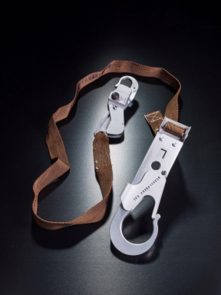
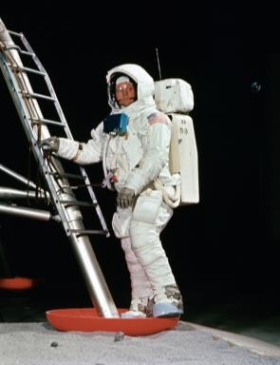
Apollo 11
NASA Training photo of
Neil Armstrong using tether
Tether
Notes:
The plan was for Apollo 11 astronauts to use a tether while exiting and reentering their lunar module, since they were uncertain as to what would happen as they left the spacecraft. They also planned to tether their equipment to the spacecraft during tricky procedures. There are no clear pictures of the tethers being used on the Moon.
Training photo: https://www.hq.nasa.gov/alsj/a11/ap11-S69-32246HR.jpg

Slide 4
Notes:
These images, taken from the Apollo 11 Press Kit show where the tether attached to the spacesuit and (roughly) where the astronauts might have attached themselves to the Lunar Module. This was the first time a person had ever walked on the Moon and they did not know what to expect. (Note—images NOT to scale)
A PDF of this press kit is inTechnical Readings.

Slide 5
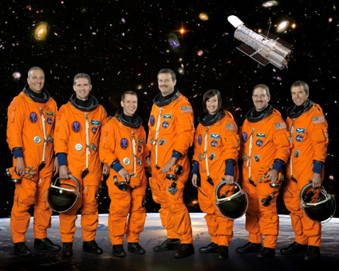
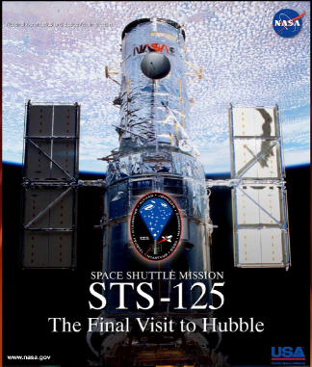
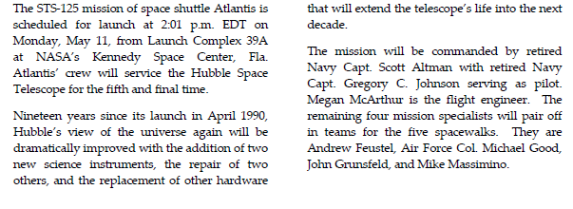
Notes:
What does STS stand for? It stands for Space Transportation System. When they were originally designing the shuttle, that was the official name that everybody gave it. When a mission is flown, it is called Space Transportation System + the mission number.
This information is from the Press Kit for STS-125. A PDF of this press kit is in Technical Readings.
Need to know more about the Hubble Space Telescope? The press kit has a nice overview.

Slide 6
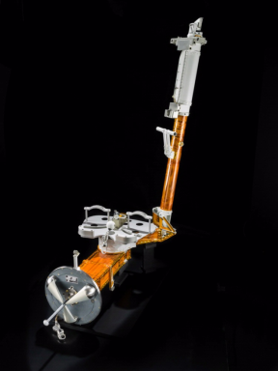
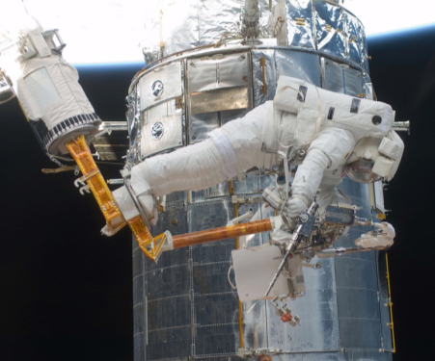
Servicing the Hubble Space Telescope
Manipulator Foot Restraint
Astronaut using the Manipulator Foot Restraint while servicing the Hubble Space Telescope
Notes:
Over the span of 16 years, there were five missions to service the Hubble Space Telescope. STS-125 was also known as Servicing Mission 4 (SM4). It was the fifth mission because the third servicing mission had to be split into two mission—called SM 3A and SM 3B. There were five spacewalks during SM4, which were planned to extend the Hubble Space Telescope’s life and leave it with new equipment that will improve the data it can send back to Earth. More than 60 new spacewalk tools, including the Manipulator Foot Restraint, were developed for work to be done on these missions.

